Slide 1

Cloud Computing

Slide 2
Cloud Computing: An Introduction
Cloud computing evolved from earlier forms of distributed computing.
Clusters, grids, and the notion of resource sharing over a network are all forerunners of clouds.
Clouds support High Performance Computing (HPC) and High Throughput Computing (HTC)
HPC: use of parallel processing to execute large programs quickly; often equated to supercomputers, typically applied to systems generating teraflops (10¹²) or more. High speed computing.
HTC: running a job that takes days to complete, or an application that must produce a high number of completed operations per unit of time.

Slide 3
What is Cloud Computing?
“…a style of computing in which dynamically scalable and often virtualized resources are provided as a service over the Internet.”
Clouds provide a level of abstraction that simplifies user access to the services it offers.

Slide 4
What is Cloud Computing?
Cloud computing covers both services provided and the software and hardware in the datacenters that provide the services.
“From a hardware perspective three aspects are new in Cloud Computing.
The illusion of infinite computing resources available on demand, thereby eliminating the need for Cloud Computing users to plan far ahead for provisioning.
The elimination of an up-front commitment by Cloud users, thereby allowing companies to start small and increase hardware resources only when there is an increase in their needs.
The ability to pay for use of computing resources on a short-term basis as needed (e.g., processors by the hour and storage by the day) ...” [“Above the Clouds: a Berkeley View of Cloud Computing” , http://www.eecs.berkeley.edu/Pubs/TechRpts/2009/EECS-2009-28.pdf ]

Slide 5

What is Cloud Computing?
The cloud consists of datacenter hardware, system software, and a variety of services.
The datacenters can be centralized or distributed.
NIST, the National Institute of Standards and Technology, prepared the following working definition of cloud computing

Slide 6
NIST Definition
“… a model for enabling ubiquitous, convenient, on-demand network access to a shared pool of configurable computing resources (e.g., networks, servers, storage, applications, and services) that can be rapidly provisioned and released with minimal management effort or service provider interaction.”
The NIST definition also identifies
5 essential characteristics
3 service models
4 deployment models

Slide 7
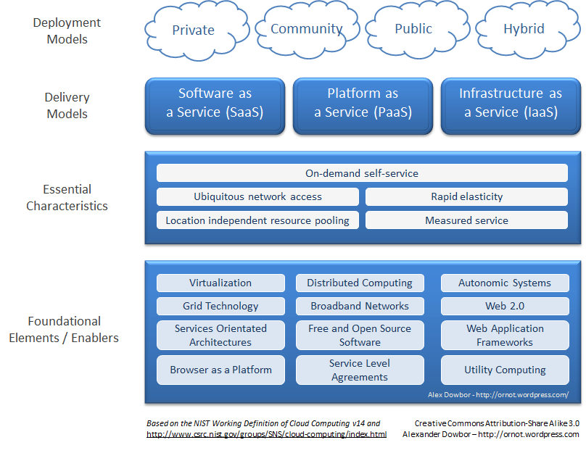

Slide 8

NIST Working Definition of Cloud Computing
Deployment Models: how are cloud resources arranged, managed
Delivery Models
Essential Characteristics
Enabling Technologies

Slide 9
Cloud Deployment Models from NIST, the National Institute of Standards and technology
Public: Accessible, via the Internet, to anyone who pays
Owned by service providers; e.g., Google App Engine, Amazon Web Services, Force.com.
Community: Shared by two or more organizations with joint interests, such as colleges within a university
Private: Accessible via an intranet to the members of the owning organization
Example: NASA’s cloud for climate modeling http://www.networkworld.com/news/2010/020110-nasa-cloud-service.html
Hybrid
A private cloud might buy computing resources from a public cloud.
Currently, public clouds are the most common although over time this may not be the case. Private clouds are easier to manage and provide greater security.

Slide 10
NIST Working Definition of Cloud Computing
Deployment Models
Delivery Models: how are services offered to cloud users?
Essential Characteristics
Enabling Technologies

Slide 11
Delivery Models: IaaS
Users interact with clouds in various ways to access its various services.
Subscription-based, pay-as-you-go
Rely on SLAs (Service Level Agreements) that specify guaranteed levels of service, bandwidth, security, etc.
Service Delivery Models
IaaS: Infrastructure as a service
PaaS: Platform as a service
SaaS: Software as a service

Slide 12
Delivery Models: IaaS
Provides access to (possibly virtualized) resources: servers, storage devices, networks..
Includes storage as a service, compute instances as a service, communication as a service.
The customer can deploy his own applications, databases, operating system environments, and so on
The customer does not necessarily have control over the underlying hardware

Slide 13
IaaS Benefits
Organizations don’t need to maintain their own data centers
Saves on staffing, reduced hardware costs, etc.
Resources can be scaled up (or down) easily
Possible security benefits
Private data centers = single point of failure
Use a cloud data center as a less-costly backup to the on-site data center

Slide 14
IaaS Example
Amazon EC2 (Elastic Compute Cloud) http://aws.amazon.com/ec2/
Users can “rent” virtual machines (called instances) and use them to run any software
Instance types: on-demand (pay as you go, no commitment), reserved (pay in advance for a certain amount of time), spot (be the lowest bidder for unused time)
“Elastic” refers to the ability to scale from 1 instance to hundreds in a matter of minutes.

Slide 15
Delivery Models: PaaS
In addition to infrastructure, PaaS supplies operating systems, programming languages, and other services which the customer can use to create and deploy applications.
As before, the user doesn’t directly control the hardware or system software, but can control his own applications.

Slide 16
PaaS Benefits
In addition to the benefits of IaaS (scalability, economy of scale, lower overhead, etc.) PaaS provides the user with current system software. Updates, patches, other issues are handled automatically.
IT department can focus on application development and do not need to deal with server-related issues.

Slide 17
PaaS Example
Force.com is a scalable and secure cloud platform from Salesforce.com, a company that specializes in customer relation software (CRM) tools. http://www.force.com/ , http://en.wikipedia.org/wiki/Force.com
It delivers a complete technology stack: from database and security to workflow and user interface.
Simplifies the development of enterprise applications:
“A comprehensive array of technologies built on top of the Force.com API dramatically simplifies enterprise application integration. Whether you need to connect to SAP, Oracle, Microsoft, or another on-premises or cloud-based application, integration now takes much less effort than ever before”

Slide 18

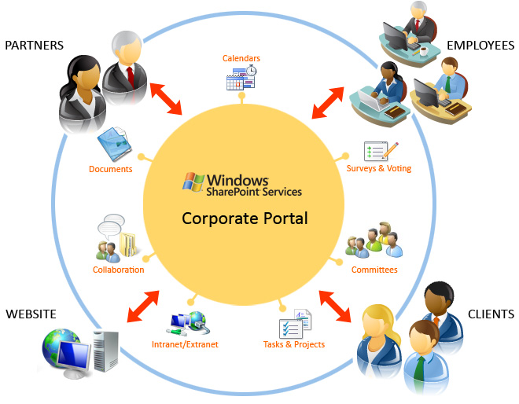
Delivery Models: SaaS
Complete software applications are offered
Customers access apps directly through Web interfaces.
Example: Gmail, SharePoint
SaaS builds on the software and resources in the Paas and IaaS layers.

Slide 19
Delivery Models: SaaS
SaaS is similar to, but more advanced than, the Application Service Providers (ASP) that host and manage software applications for businesses.
ASPs managed 3rd party software, SaaS providers develop their own
ASP generally provided a separate instance of the software/hardware platform for each customer but SaaS often supports multitenant solutions.

Slide 20
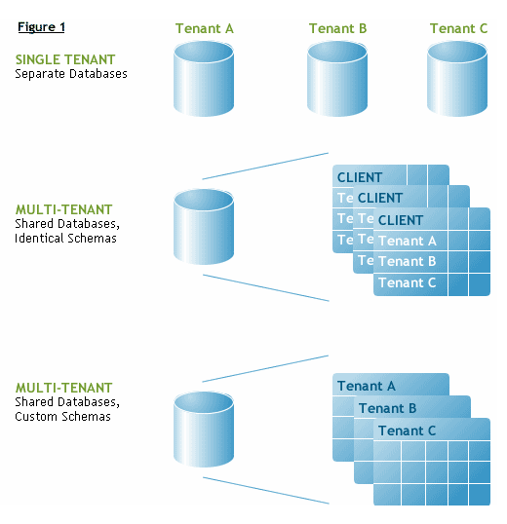
SaaS: Multitenant Architecture
Customers may share the same server & even the same software; e.g., a database
Data is partitioned and remains private
Saves money; e.g., only pay for one license, only maintain one copy, …
Compare to virtualization, where each customer appears to be running on a single machine.

Slide 21
SaaS: Advantages
Reduce or eliminate need for on-site data center
Pay-as-you-go model, no big up-front investment in either hardware or software
Scalability in number of servers, amount of storage, etc.
Device-independent access to applications
Improved disaster recovery, less interruption, (ideally – but … what about Google outages?)

Slide 22
NIST Working Definition of Cloud Computing
Deployment Models
Delivery Models
Essential Characteristics: what features should cloud users expect?
Enabling Technologies

Slide 23
Characteristics of Clouds (NIST report)
On-demand self-service: consumers can acquire the necessary computational resources without having to interact with human service providers.
Ubiquitous network access: cloud features don’t require special devices – laptops, mobile phones, etc. are generally supported.
Resource pooling: cloud resources are pooled to serve many customers “… using a multi-tenant model, with different physical and virtual resources…”

Slide 24
Characteristics of Clouds (NIST report)
Rapid elasticity: resources can be allocated and de-allocated quickly as needed.
Measured service: resource use is measured and monitored; charges are made based on usage and service type (e.g., storage, CPU cycles, etc.)

Slide 25
NIST Working Definition of Cloud Computing
Deployment Models
Delivery Models
Essential Characteristics
Enabling Technologies: what are the underlying capabilities of the cloud?

Slide 26
Enabling Technologies & Concepts
Virtualization
Supports virtual clusters, sharing of hardware among several users, load balancing through VM migration, etc.
Multiple servers can share a single computer or a shared cluster for improved CPU utilization.
Support for legacy systems based on old operating systems and applications
Customers can choose their preferred OS; different apps with different OS’s can run on the same hardware.
Example: Amazon’s EC2 provides an API that allows users to configure virtualized hardware to support any kind of application.

Slide 27
Enabling Technologies & Concepts
Clustering/grids
“…enables scalable parallel and distributed computing…”
Clouds make use of existing data centers, based on cluster and grid technology
Combining existing hardware with virtualizing software makes it possible to provide the elasticity that characterizes cloud computing.
Large data centers

Slide 28
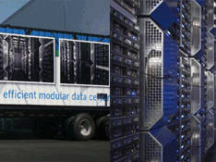
SGI Ice Cube data center
Outside: 20’ x 40’, inside: an up-to-date data center complete with power, cooling facilities, racks for SGI servers and storage systems, et.

Slide 29
Enabling Technologies & Concepts
Autonomic systems: self-managing; the ability of a system to make decisions based on built-in policies.
Self-monitoring, self-correcting
Hides the complexity of distributed systems
Example: load balancing
Demands for a given service vary over time
During slack periods one virtual server may be sufficient; when client requests increase an autonomic system can allocate a load balancing server to direct requests to two or more servers in a round-robin fashion. When demand decreases, return to original level.

Slide 30
Enabling Technologies & Concepts
Service Oriented Architectures (SOA)
A software architecture describes the components of a software system and connections between components. It deals with external, not internal issues, e.g. APIs.
In SOAs, the components include various web services, self-contained, modular components that communicate in some standardized way (XML, SOAP, …) and can be easily integrated into other applications.
The World Wide Web Consortium defines a web service as “a software system designed to support interoperable machine-to-machine interaction over a network ”
Web services interface to each other, not users. A developer builds an application from web services and provides it with a GUI to interface to users.

Slide 31
Enabling Technologies & Concepts
Web Services - Restful
RESTful web services (Representational State Transfer): (Hwang) expose a set of resources (documents, templates, etc.) identified by a name (URI). HTTP is the standard interaction protocol. Interactions are stateless. Used in Web 2.
More heavy-duty Web services are build on SOAP, WSDL, and UDDI

Slide 32
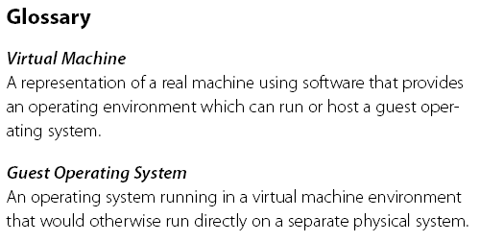
Virtual Machine, Guest Operating System, and VMM (Virtual Machine Monitor) :
The Virtualization layer is the middleware between the underlying hardware and virtual machines represented in the system, also known as virtual machine monitor (VMM).

Slide 33
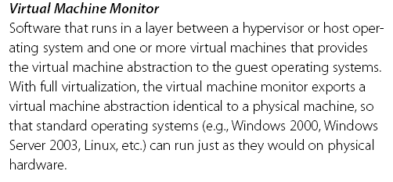
VMM : Virtual Machine Monitor

Slide 34
Example:
Stand alone controllers that monitor building HVAC, electrical, and other systems can be networked to provide integrated building automation and energy management.
“Smart” buildings
e.g., reduce power consumption by adjusting lighting & heat based on current occupancy

Slide 35
Enabling Technologies & Concepts
Utility Computing: the business model in which consumers pay for services according to the amount and type used.
“Plug into the cloud” and connect to your service/platform/hardware
The service provider monitors usage and bills on a monthly or other basis.
Grids and clouds are both classified as utilities, but clouds offer more features than the typical grid, and usually support easier interaction.
Utility computing is a feature of public clouds.

Slide 36
Enabling Technologies & Concepts
Browser as a Platform
A computing platform includes a hardware architecture and software framework (including applications), where the combination allows software, particularly application software, to run.
“Browser as a platform” indicates the use of a browser as the interface to application software.
Other technologies: broadband networks, free & open source software, service level agreements, etc.

Slide 37
Cloud Design Objectives
Data storage, processing, software moves off the desktop and into the cloud
Users enter into Service Level Agreements (SLAs) with providers and pay based on the SLA
Cloud must be able to scale resources and services as the user’s needs grow (or shrink)
Privacy must be guaranteed!
Quality of service should be standardized.
Standards must be agreed on to prevent data lock-in, which means that once a customer is committed to one service provider it is not possible to shift to another.

Slide 38
Other Cloud Topics
In the technical report “Above the Clouds: …” Armbrust et al. address a number of issues related to cloud computing.
Brief overview of a few:
The economics of cloud computing
Obstacles and opportunities
Clouds as a facilitator of new services

Slide 39
The Economics of Cloud Computing
Cloud computing shifts capital expenses (for hardware, software to run large datacenters) to operating expenses for cloud services
Potential to save money: an estimated server utilization rate of 5% to 20% is reported by Armbrust, et al. for private data centers primarily because users provision for peak loads.

Slide 40
Cloud Economics – Elasticity Example
Assumptions:
A service requiring 500 servers at noon, 100 servers at midnight provisions for peak load (500)
Average utilization over 24 hours = 300 servers
Daily usage: 24 x 300 = 7200 server-hours
Actual capacity: 24 x 500 = 12000 server-hours
Capacity/usage ration: 1.7
Compare the pay-as-you-go cost of utility computing for 3 years (equipment lifetime) to the cost of buying the servers, go with the cloud if it will save money.

Slide 41
Cloud Economics – Transferring Risk
Suppose a private data center is sized to meet the expected peak load, but some event (e.g., exciting new product, great reviews) drives even more customers to the site.
Of the potential new customers turned away because of overloading, some percentage will never return
Loss of potential customers plus possible bad press could have been averted with a more flexible (i.e., cloud) system.
For more about economics, read the Armbrust report.

Slide 42
Obstacles and Opportunities
Service availability:
consumers fear the loss of availability either through data center failure or simple under-provisioning of the cloud
Distributed denial of service attacks by criminals who rent bots to launch attacks & then demand payment to stop.
Defense
Use more than one company
Scale up to a larger number of computers which will cost the attackers more, making it difficult to sustain the attack.
See the Berkeley paper “Above the Clouds…” for 9 more

Slide 43
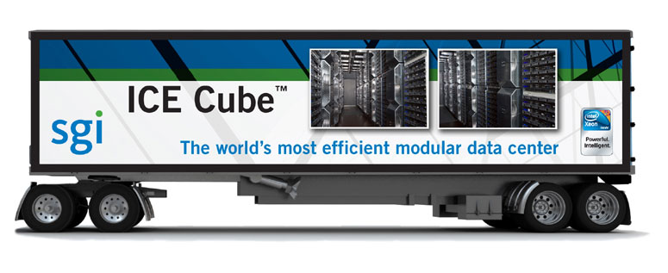
Data Centers
A centralized collection of data, usually related to a single business or subject
for example: Google data centers, National Climate Data Center
Data centers typically provide data storage and management and make the data available to the public, a paying client, …
Data centers in cubes are mobile

Slide 44
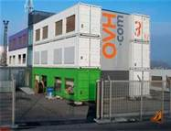
A Container Cube Data Center
Built-in climate control, power, etc. makes container cubes self-sufficient.
No need for a building
Mobility – able to move to a more congenial environment.

Slide 45
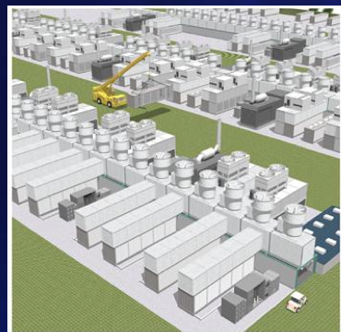
Courtesy: Dan Reed, Microsoft

Slide 46
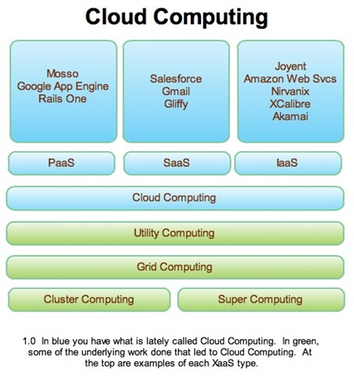
Another Look at Cloud Technology

